Slide 1
Burnout in Academics: The Female Perspective
Corrie M. Yablon, M.D.
Associate Professor

Slide 2
Disclosure
None

Slide 3
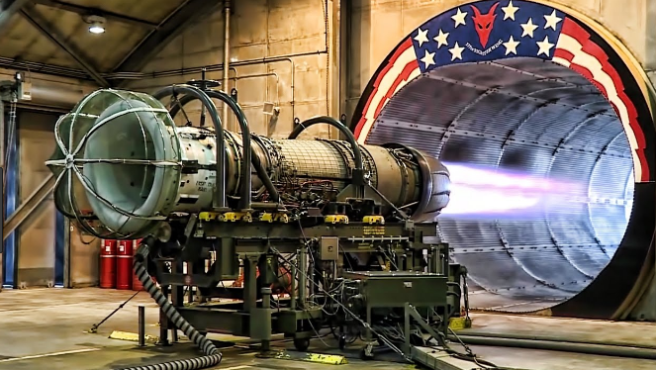
Burnout: Background
Maslach – 1st to study it
Individual risk factors
An environmental problem
“Major mismatch between the nature of the job and the nature of the person who does the job”
Emotional exhaustion, depersonalization, reduced personal accomplishment
https://www.youtube.com/watch?v=Oj4w7i-TqsE
Maslach C, The Truth about Burnout: How Organizations Cause Personal Stress and What to Do About It.
San Francisco, CA:Jossey-Bass; 1997

Slide 4

Contributors to Burnout
Demographics
  Female 48% vs.
  male 38%
  Age 45-54
Radiology #7 of 29 specialties
Maslach C, The Truth about Burnout: How Organizations Cause Personal Stress and What to Do About It.
San Francisco, CA:Jossey-Bass; 1997; Medscape Burnout and Depression Survey, 2018

Slide 5
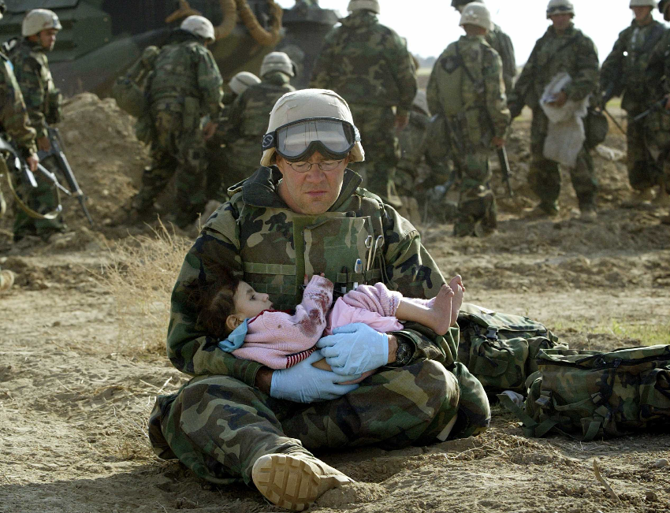
Contributors to Burnout
Concept of “moral injury”
  First used in military
  Veterans’ psychological sequela to “bearing witness to the aftermath of violence and human carnage”
  Nursing literature
  A person’s response to the “betrayal of what is right”
Conflict between ideals and work environment
Litz BT, Stein N, Delaney E, et al. Moral injury and moral repair in war veterans: a preliminary model and intervention strategy. Clin Psychol Rev 2009;29:695–706.
Fourie C. Who is experiencing what kind of moral distress? distinctions for moving from a narrow to a broad definition of moral distress. AMA J Ethics 2017;19:578–84

Slide 6

Being Female: Academics
Promotion
Leadership opportunities
Invisible
Gender stereotypes
  Men: competent
  Women: incompetent
“Bro” environment at some meetings
  #Time’sUp
Image: https://www.google.com/search?rlz=1C1GGRV_enUS750US750&biw=1164&bih=557&tbm=isch&sa=1&ei=hx_nWvr9EaLdjwT2i5GICw&q=men+exclude+women&oq=men+exclude+women&gs_l=psy-ab.3...70176.76670.0.76928.53.37.0.0.0.0.180.4219.11j22.34.0....0...1c.1.64.psy-ab..33.9.967.0..0j0i67k1j0i5i30k1j0i8i30k1.111.f9HvTT_Ysz8#imgrc=SxgcHphVYzutaM:

Slide 7

Management
Hierarchical
Poor communication
Lacking fairness
  Salary, time, workload
No empathy
  No positive acknowledgment
  We are expendable
Sucks the joy out of work
Maslach C, The Truth about Burnout: How Organizations Cause Personal Stress and What to Do About It. San Francisco, CA:Jossey-Bass; 1997; The Simpsons, 20th Century Fox
https://www.proopinion.com/en/blog/10-signs-of-a-toxic-boss

Slide 8
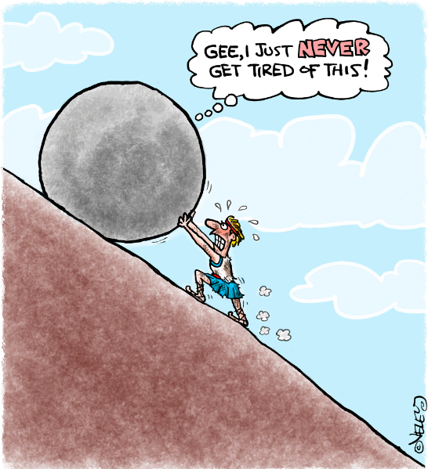
Operations
Inefficiencies
Understaffing
EMR, PACS, IT
Much non-interpretive work
Interruptions
Emphasis on volume vs. value
Loss of autonomy and control
J Am Coll Radiol. 2016 Oct;13(10):1210-1214. Epub 2016 Jun 14
http://capreform.eu/simplification-as-a-top-priority-in-2015; J Am Coll Radiol. 2016 Oct;13(10):1210-1214. Epub 2016 Jun 14

Slide 9

Environment
Isolation
Off-site rotations
Increased commutes
Diminished interaction w other radiologists, trainees, department
https://www.pinterest.com/pin/187814246932248661/?autologin=true

Slide 10
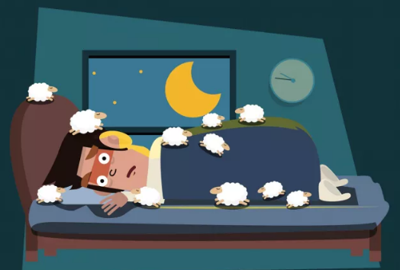
Symptoms
Medical problems
  Migraine, arrhythmias, depression, anxiety, GI, cardiac issues, back pain, MSK symptoms, exhaustion, insomnia
  Absenteeism
Overwhelmed by daily stresses
Diminished:
  Concentration, initiative
  Civility
Dread going to work, can’t wake up
https://lifehacker.com/why-insomnia-happens-and-what-you-can-do-to-get-better-1746010695
Maslach c. Burnout: The Cost of Caring. Los Altos, CA: Malor Books; 2015

Slide 11

Solutions
Stop
Reflect
How did I get here?
Where do I want to go?
http://www.architectureartdesigns.com/30-magical-zen-gardens/

Slide 12

What is Your “Why”?
What drives you?
What gives you purpose?
https://cranialintelligence.com/2010/04/27/the-horizon-and-the-central-nervous-system/
https://www.kevinmd.com/blog/2018/04/physicians-find-your-why-to-help-with-burnout.html

Slide 13


What Can You Control?
Invest in:
  Self
    Sleep, exercise, nutrition, hobbies, gratitude
  Relationships
Diminish isolation
Live WAY below your means!

Slide 14
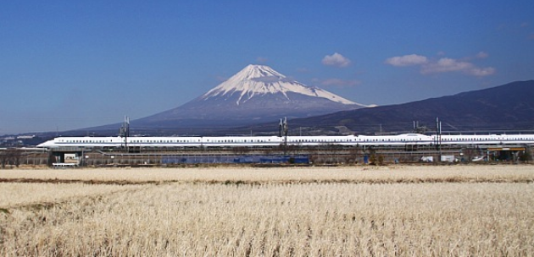
Time Management
Can only manage self, not time
Everything takes longer than you think
Say ‘no’ more often
https://toggl.com/time-management-tips/;https://www.japan-guide.com/e/e2018.html

Slide 15

Career
Get a sponsor
Mentor others
What brings you joy?
Choose only projects that align with your interests or goals
Bias: discuss and share
  Don’t “shame”
Document accomplishments
https://treeottawa.files.wordpress.com/2014/05/pbt-hero.jpg

Slide 16

Problem
Mindfulness and individual solutions only get me so far…
What about my (insert adjective here) work environment?
http://cliparting.com/wp-content/uploads/2017/04/Question-marks-clipart-2.jpg

Slide 17
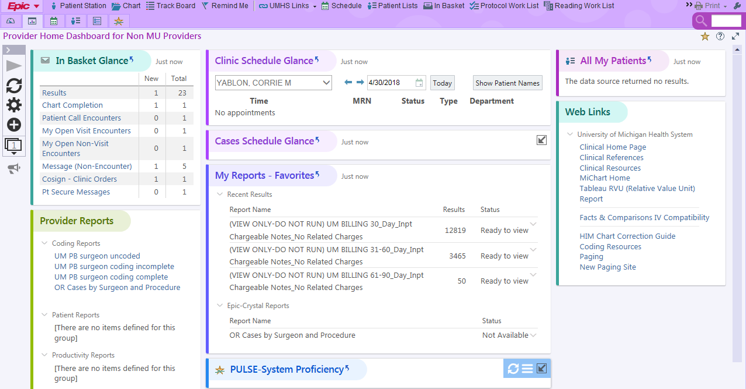
Your Work Flow
Optimize EMR, VR, etc.
What can you fix?
What do you have to make peace with?

Slide 18
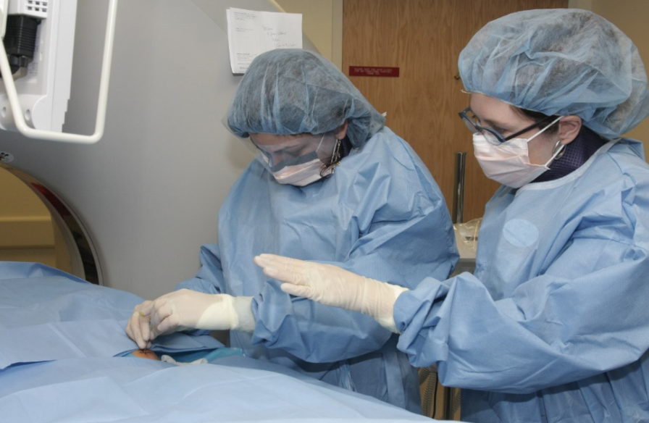
Your Teaching
Who’s with you today?
Teach to learner level
  Med students
  Residents
  Fellows
  Faculty observers

Slide 19
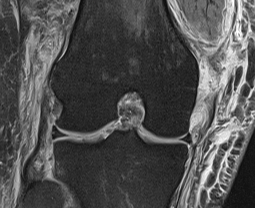
Your Clinical Expertise
Focus on your strengths
Be the expert at what you love
Don’t sweat the small stuff
Document your accomplishments

Slide 20

Your Network
Section
Department
Women in Radiology group*
Hospital
National societies
Mentors
Sponsors
Social media
Isolation = despair
Gaetke-Udager K et al. AJR Am J Roentgenol. 2018 Apr 27:W1-W5.--https://www.aeroprofessional.com---HewlittSA, “Forget a Mentor, Find a Sponsor” HBR Press, 2013.

Slide 21

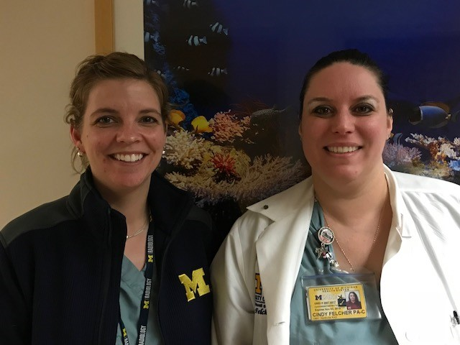

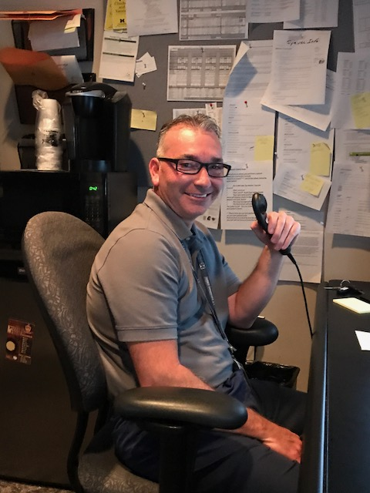
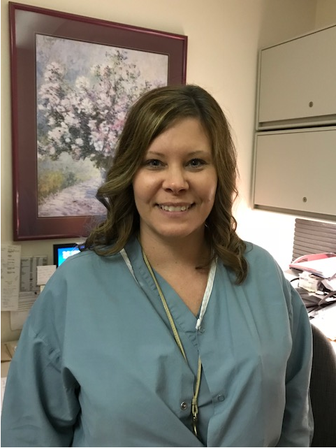
Assistants
At U of M:
  Reading room coordinators
  Physician Assistants
  Technologist Assistants
  MSK US Techs
  Administrative assistants

Slide 22

Be A Change Agent
Don’t have to be the “one in charge”
What is your vision for the future?
Study problem, gather facts
Patient persistence
Create buy-in
Bridges to stakeholders
  Techs, managers, faculty, administration

Slide 23

Take Home Points
Develop your self before your career
Focus on the things that bring you joy
Avoid isolation
Optimize what you can, make peace with the rest
Be an agent for change
Find your “why”
https://www.tripadvisor.com/Attraction_Review-g60834-d126771-Reviews-Rainbow_Bridge_National_Monument-Page_Arizona.html

Slide 24
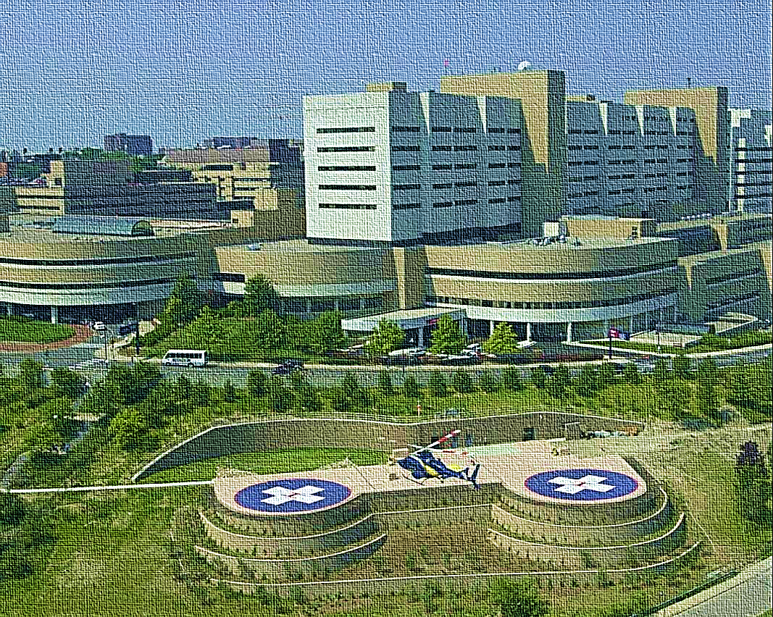
Thank You
Corrie M. Yablon, M.D.
cyablon@med.umich.edu

Slide 25
Arrows

